Slide 1
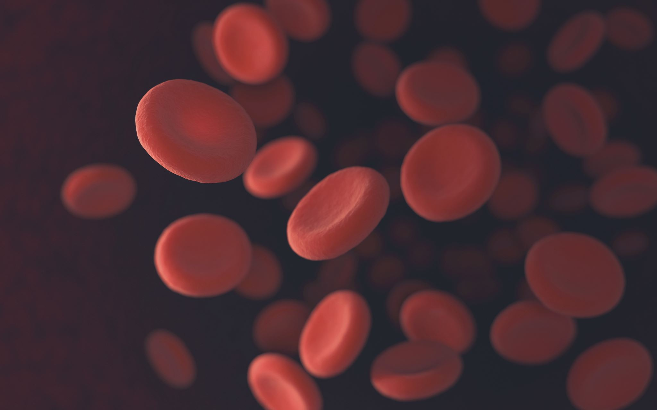
Blood Glucose Prediction
Opencampus - Advanced Time Series
WiSe 24/25
Anna Dahlhaus, Christopher Kunze, Tim Oldörp, Leo Simak

Slide 2
Overview
Introduction & domain background
HUPA-UCM Diabetes Dataset
EDA
Problems and solutions
Feature engineering
Models
Baseline
ARIMA
Tree models: Random Forest & XGBoost
Neural networks: GRU, LSTM, N-Hits, Chronos
Result overview
Discussion & Outlook

Slide 3
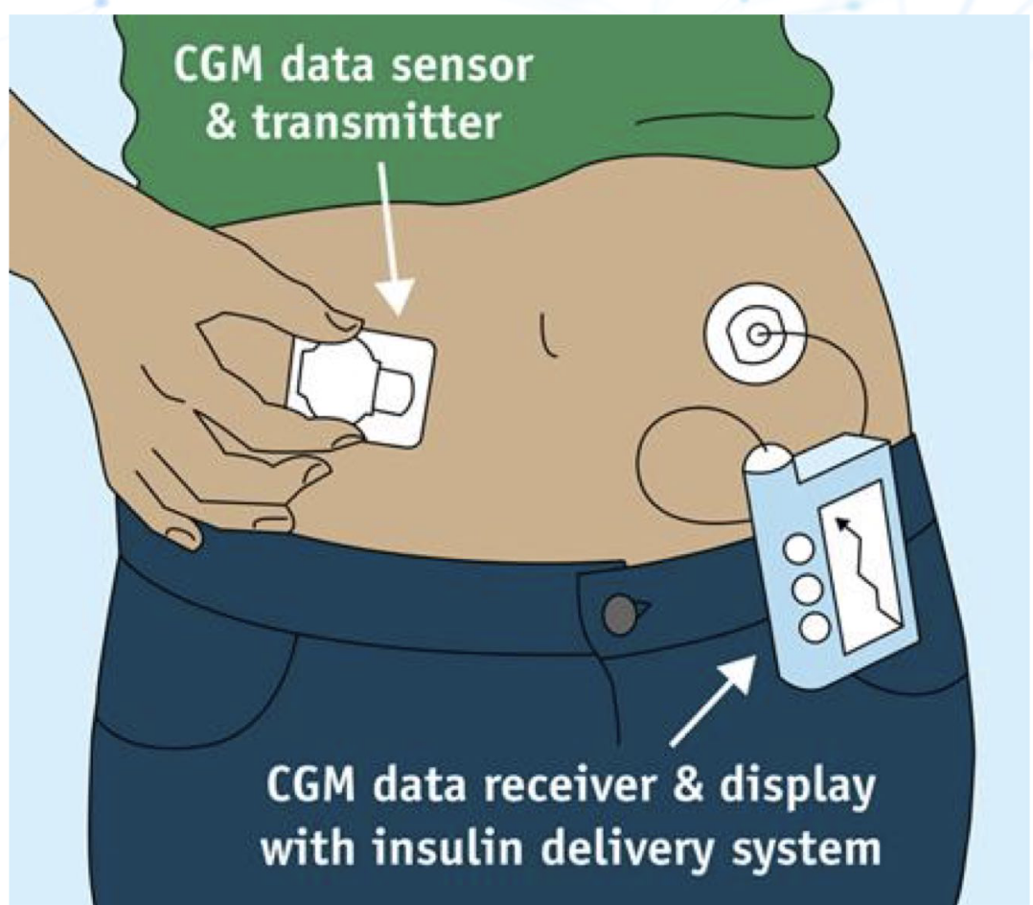
Introduction
Task:
Predict future blood glucose values
Dataset: HUPA-UCM Diabetes Dataset:
25 people with Type 1 Diabetes Mellitus (T1DM)
Continuous Glucose Monitoring (CGM) data over several days (>7d)
Fitness tracker data: Steps, Heart rate, Burned calories, (sleep)
Carbohydrate intake & Insulin dosages (Basis + Bolus)

Slide 4
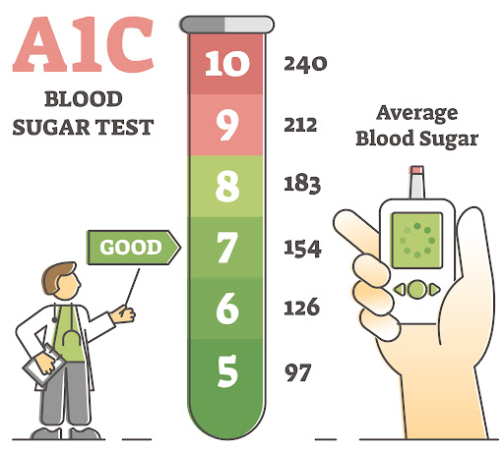
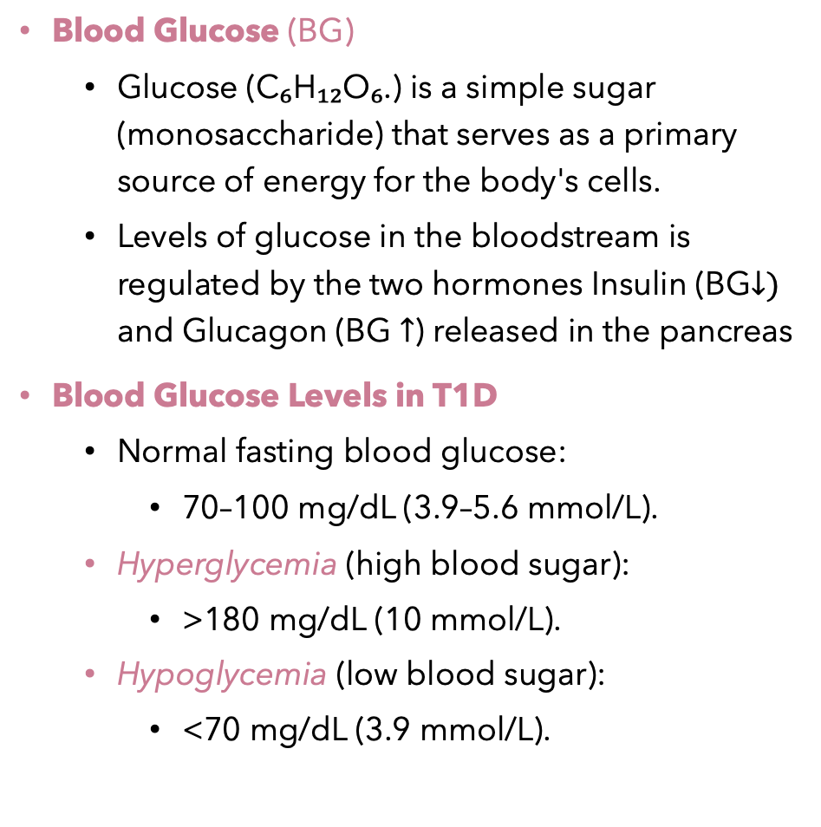
Basic Domain Knowledge Blood Glucose
Blood Glucose (BG)
Glucose (C₆H₁₂O₆.) is a simple sugar (monosaccharide) that serves as a primary source of energy for the body's cells.
Levels of glucose in the bloodstream is regulated by the two hormones Insulin (BG$↓)$ and Glucagon (BG $↑$) released in the pancreas
Blood Glucose Levels in T1D
Normal fasting blood glucose:
70–100 mg/dL (3.9–5.6 mmol/L).
Hyperglycemia (high blood sugar):
>180 mg/dL (10 mmol/L).
Hypoglycemia (low blood sugar):
<70 mg/dL (3.9 mmol/L).

Slide 5
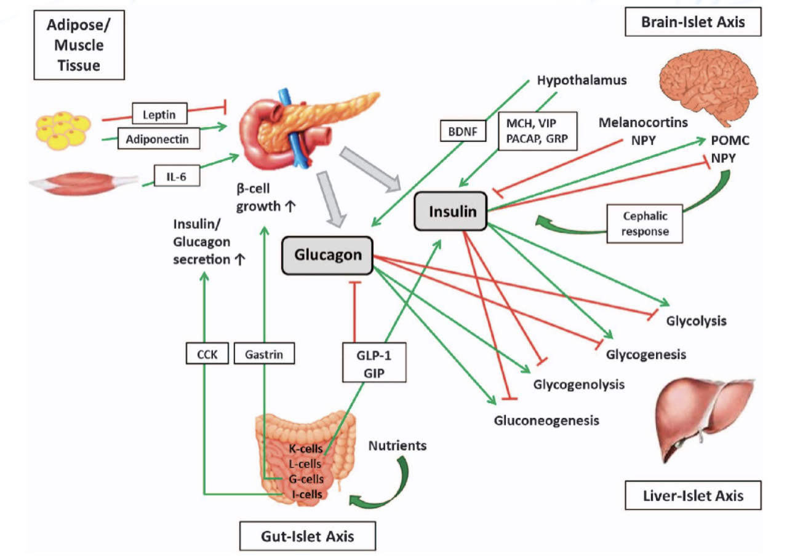
Type 1 Diabetes Mellitus (T1DM)
70-120
<70
>180
Autoimmune disease : Immune system destroys the insulin-producing beta cells in the pancreas
Without insulin, the body cannot regulate blood glucose levels effectively
Therapy:
Administering insulin (via injections or pumps):
Basal insulin: longterm basis
Bolus insulin: short term before meals
Monitoring blood glucose levels
Balancing carbohydrate intake, physical activity, and medication
Regular monitoring helps prevent complications like heart disease, nerve damage, and kidney problems.

Slide 6
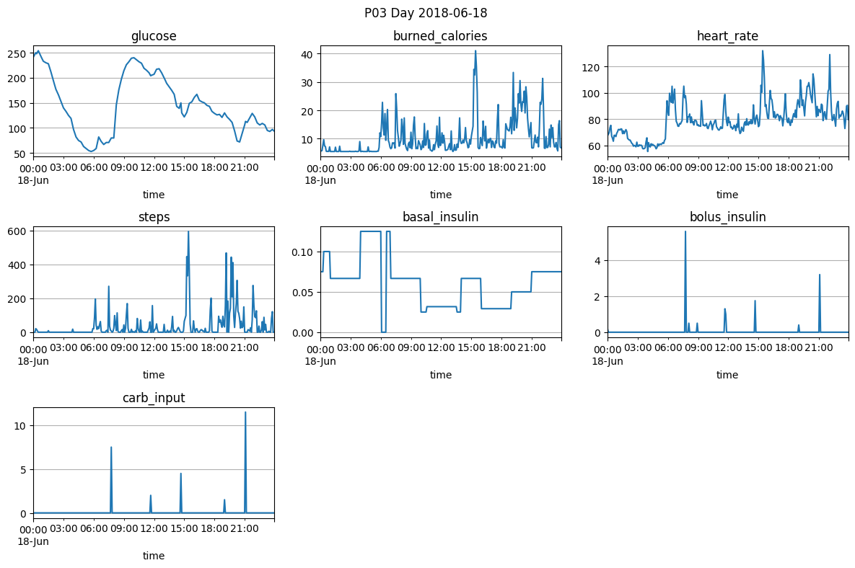
HUPA-UCM Diabetes Dataset
25 subject, multiple days each (>7d)
Preprocessed 5-min data for glucose, insulin doses, carb intake & metabolic markers

Slide 7
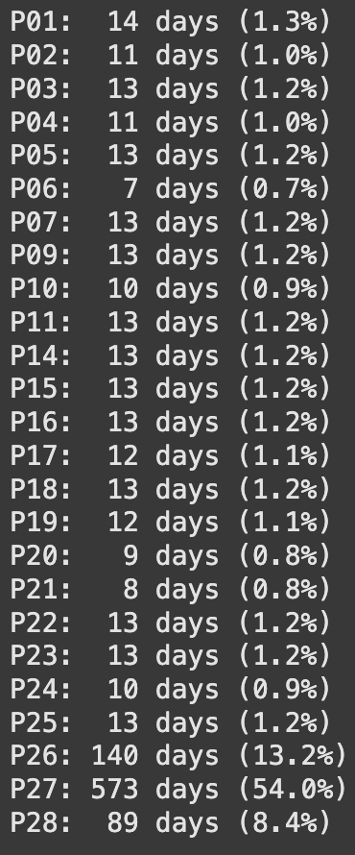
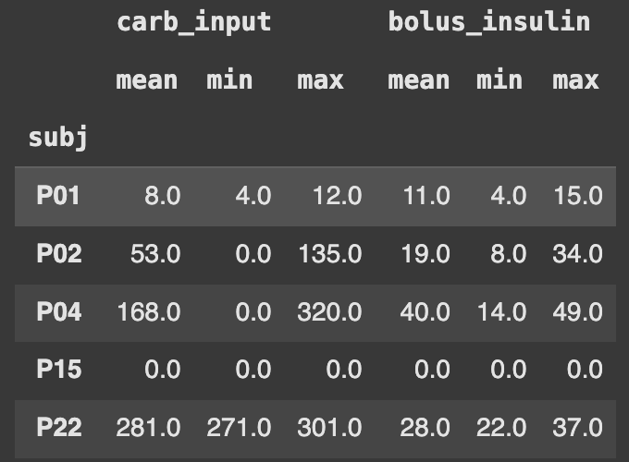
Exploratory data analysis
Vastly imbalanced data between subjects!
> 50% of the dataset is just one subject: P27
~75% is from P26, P27 or P28
All other just contribute ~1% each
Data quality is mixed 😕
Missing data: e.g. P15 has no tracking of carb_input nor bolus_insulin
Carb_input has different scales between subjects (µ = 8 vs. µ=281)

Slide 8
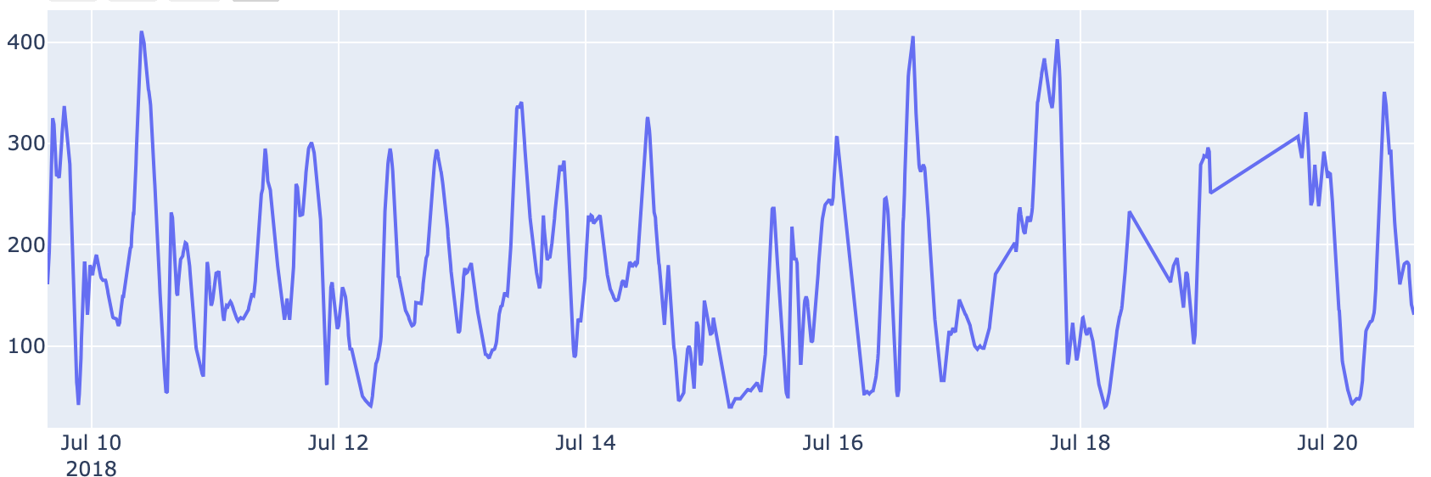
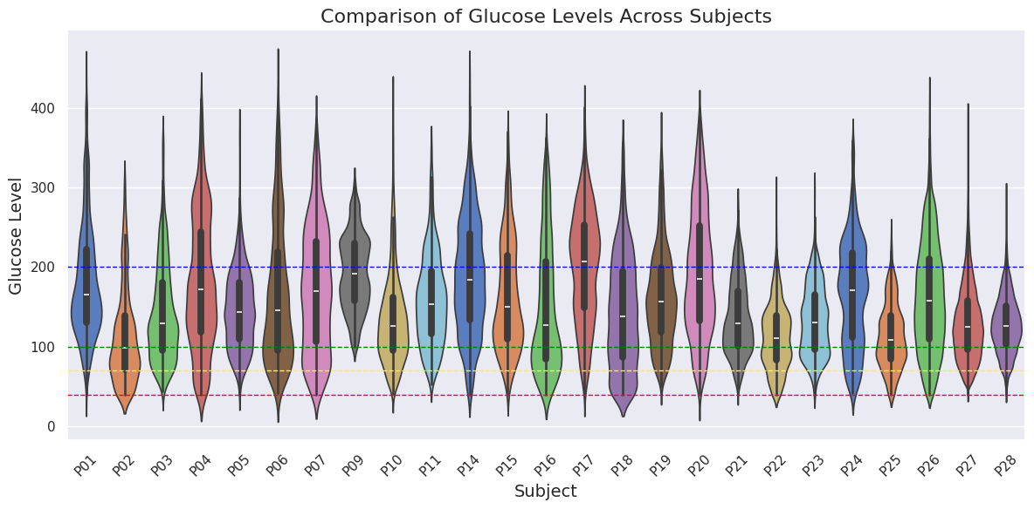


Target: Glucose
Glucose levels P04
Severe cases of hypoglycemia and hyperglycemia present
Missing data was linearly interpolated
Big interindividual differences in therapeutic success

Slide 9
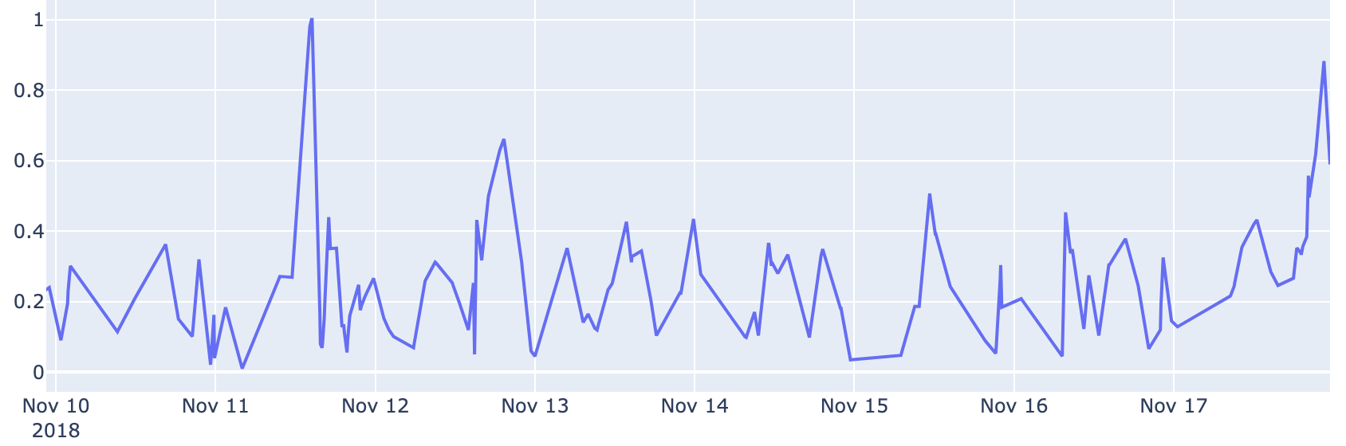
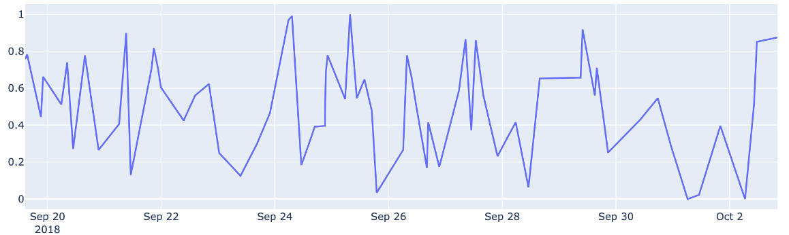
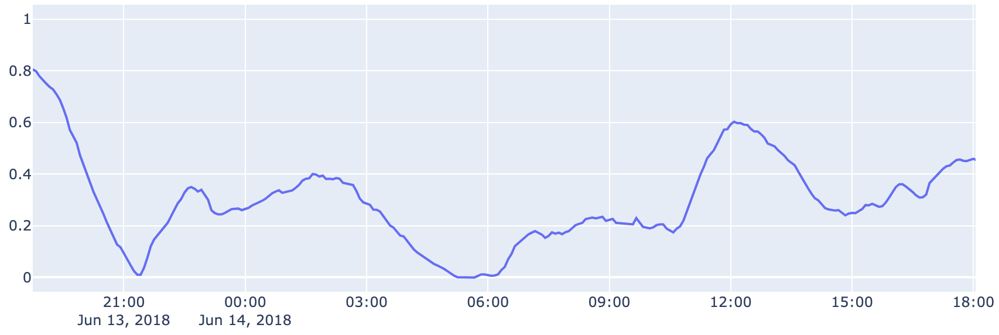
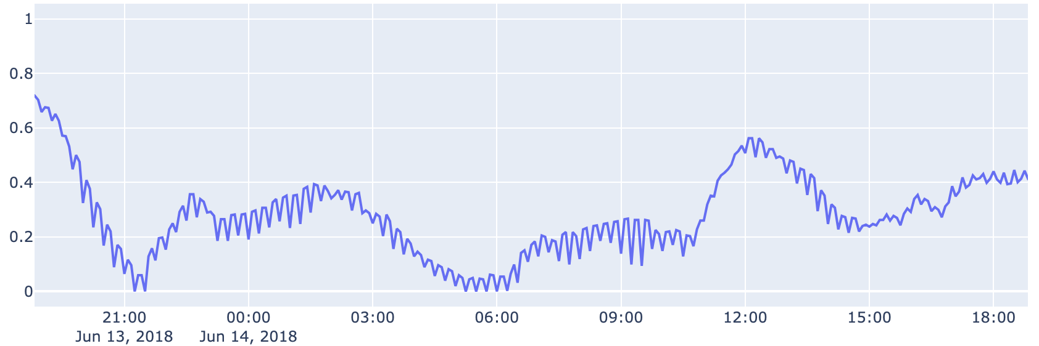
Problems found
Glucose levels P09
2 subjects (P09 & P10) have extremely low measurement frequency
Bad quality!
➔ Delete from dataset
Subject P01 has weird ripple effect
interpolation artifact?
➔ MA-smoothed
Glucose levels P10
Glucose levels P01

Slide 10
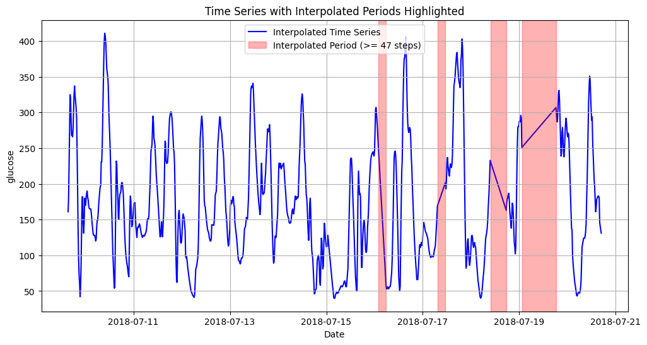
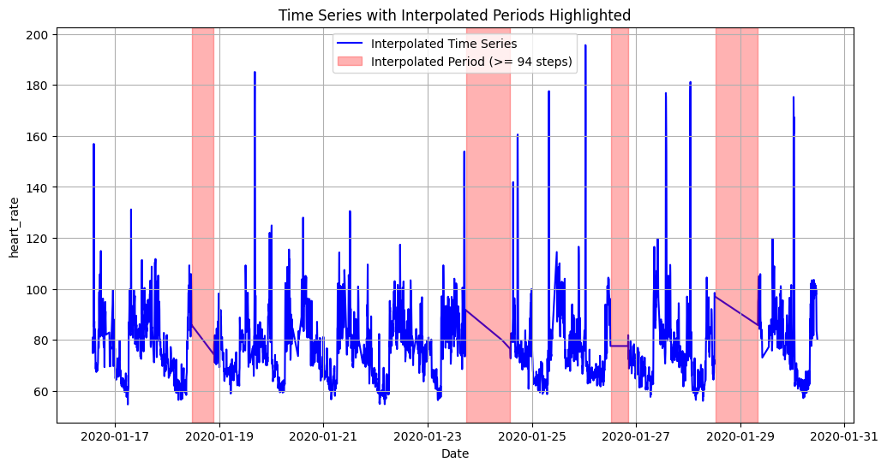
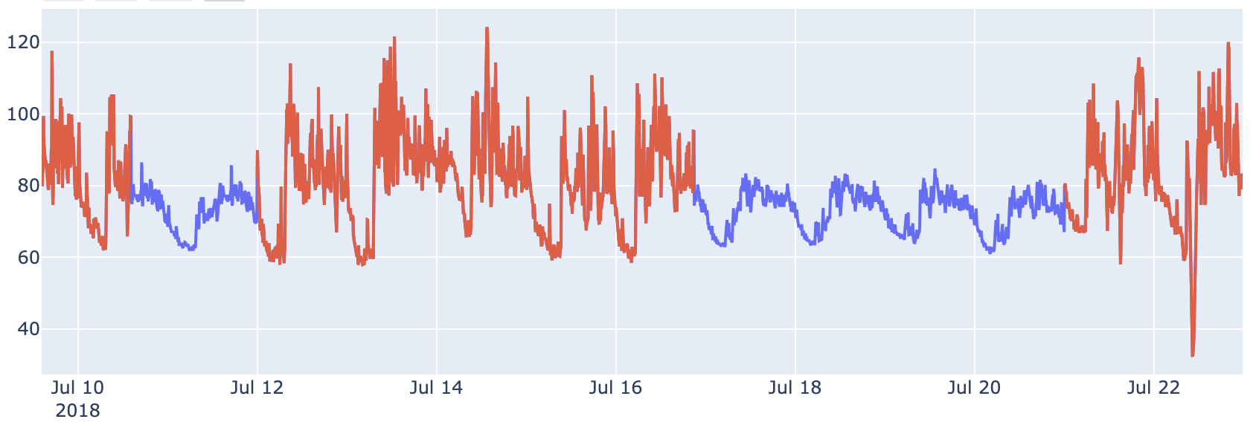
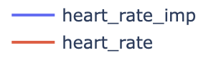
Interpolated data
Missing data were not marked but either set to zero (carb, insulin, steps, calories) or linearly interpolated (heart rate, glucose)
Detected using smoothing threshold (2nd derivative)
“Multiple Imputation with Chained Equations” was used to impute missing heart rate measurements
Glucose imputation: Mean value

Slide 11
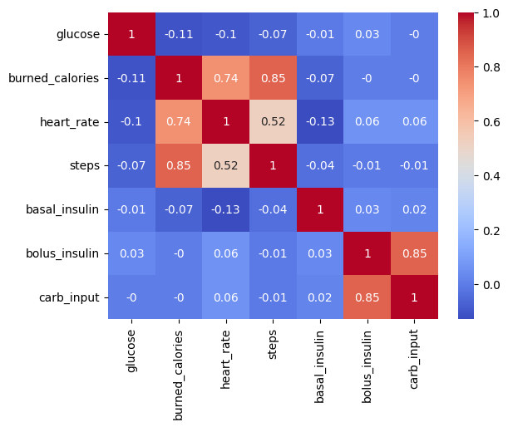
Feature Correlation
Some features are strongly correlated
Bolus insulin is given before meals and is thus dependent on carb input
Burned calories, heart rate and steps were all measured using a fitness tracker. Burned calories were properly approximated using heart rate and steps
Only linear dependence captured

Slide 12
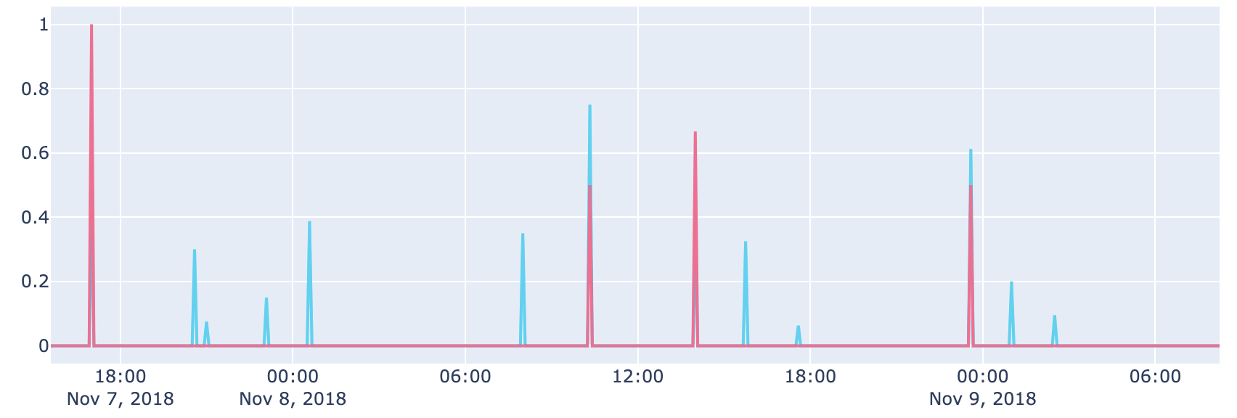

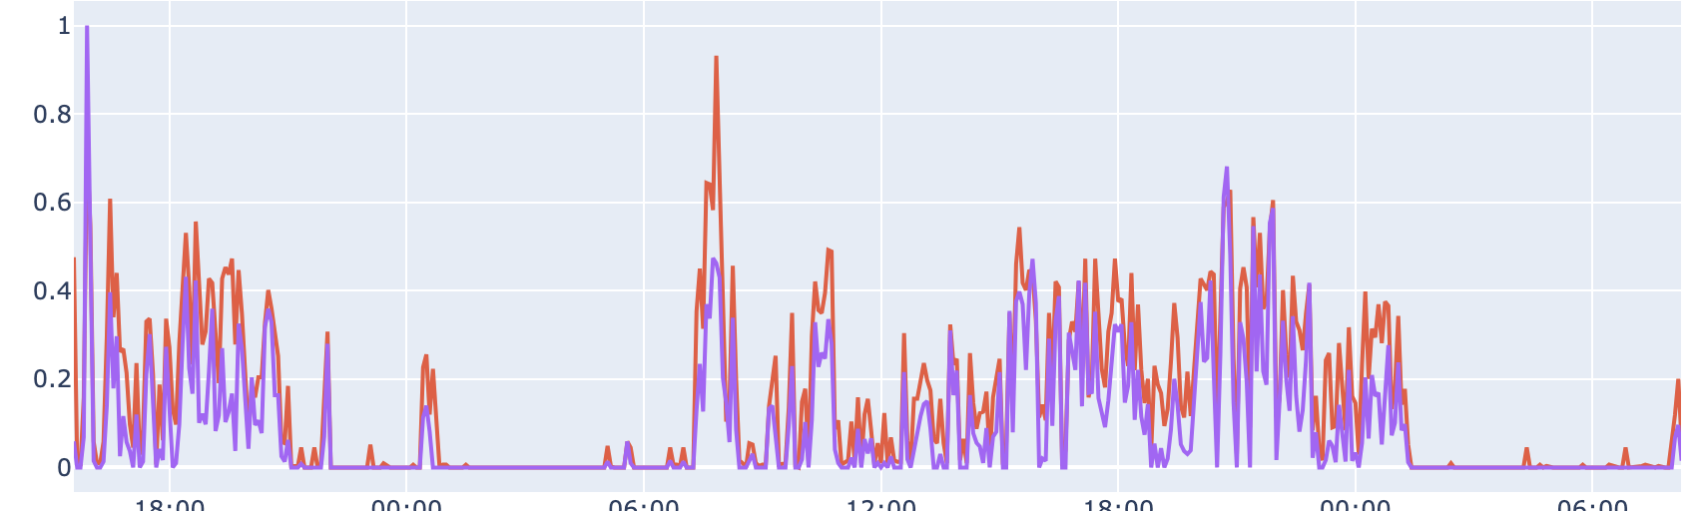
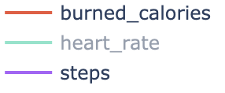
Feature selection
Carb input removed
Strong correlation with bolus insulin but worse data quality
Steps removed
Strong correlation with burned calories (basis of approximation)
New feature time_of_day: sin/cos encoded
→ To capture circadian rhythm

Slide 13
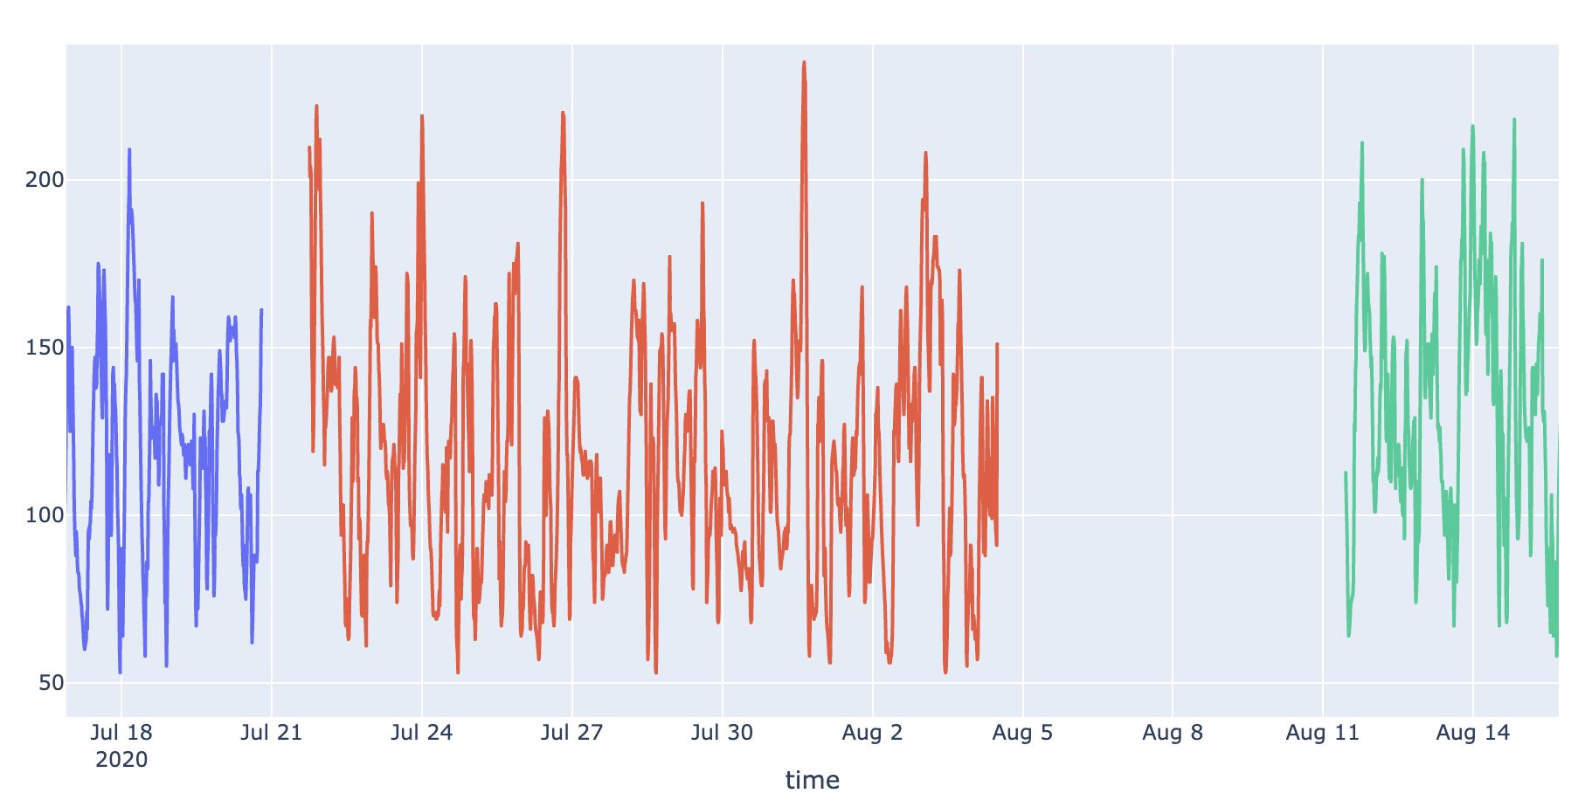
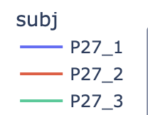
Split patients on big gaps?
Gaps >12h or more

Slide 14
evaluation
Task 1 - Predict the glucose level 1h in advance for one subject
1a: Training on the same subject’s data
1b: Training augmented with other subjects’ data
Task 2 - Predict the glucose level 1h in advance for multiple subject
2a: Training on one other subject’s data
2b: Training on other subjects’ data
P27
P27
P27
P_Train
P27
P27
P_Test
P27
P_Train
P_Test
Task 1a
Task 1b
Task 2a
Task 2b

Slide 15
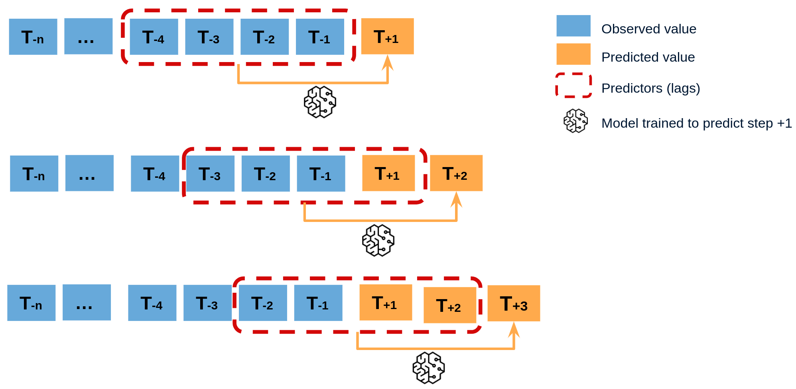
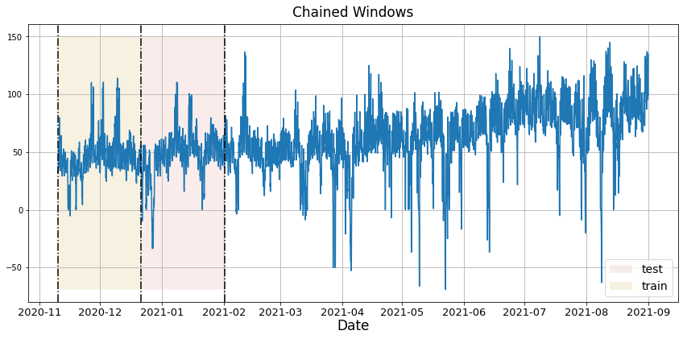

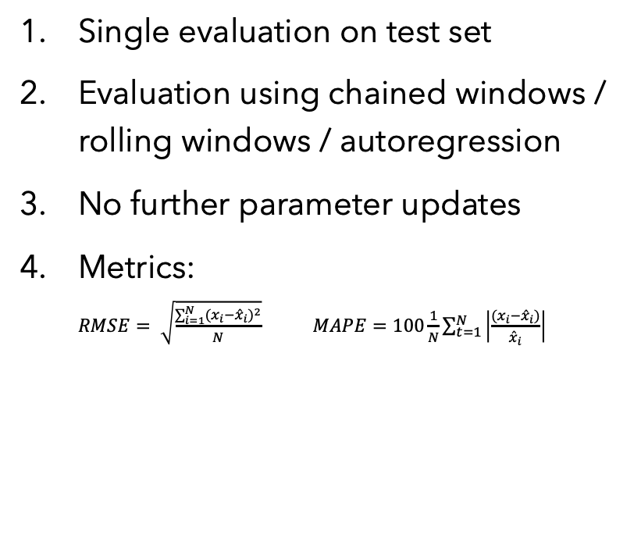
Evaluation rules
Single evaluation on test set
Evaluation using chained windows / rolling windows / autoregression
No further parameter updates
Metrics: $RMSE= \sqrt{\frac{\sum_{i=1}^{N}{{{(x}_{i}−{\hat{x}}_{i})}^{2}}}{N}}$ $MAPE=100\frac{1}{N}\sum_{t=1}^{N}{\left|\frac{{(x}_{i}−{\hat{x}}_{i})}{{\hat{x}}_{i}}\right|}$
1 time use
Train data
Test data
Val data
∞

Slide 16
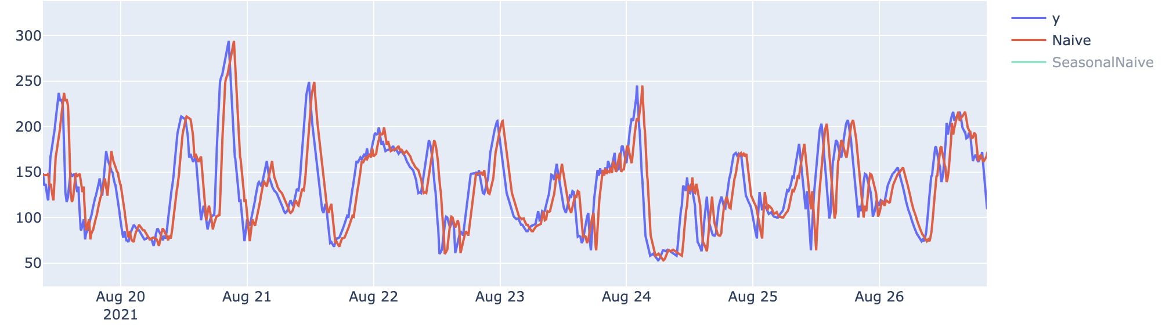
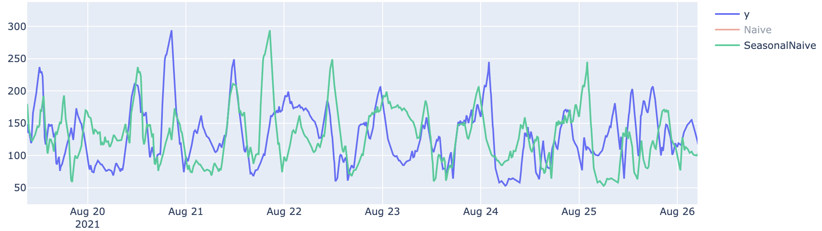
Baseline Model: (Seasonal)Naive
Naïve model - All forecasts have the value of the last observation (aka shift data by 1h)
Season naïve - All forecasts have the value shifted by one season (e.g. 24h)
Naive | RMSE | MAPE
Task 1* | 28.2 | 16.9%
Task 2* | 48.2 | 25.2%
*no difference between a and b
S-Naive | RMSE | MAPE
Task 1* | 63.0 | 42.5%
Task 2* | 86.0 | 51.2%
*no difference between a and b

Slide 17
Next step
Maybe using several previous values?
Different weighting?
Smoothing?
Combinging lags and seasonality?
➔ That’s an (S)ARIMA model ;)

Slide 18
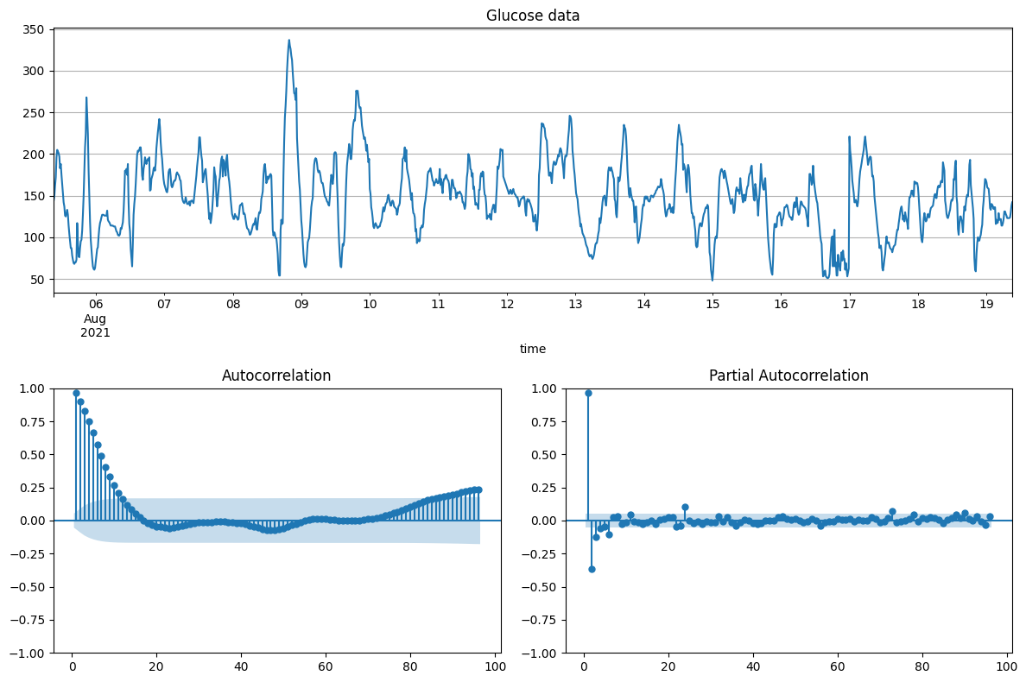
Arima & SARima
ADF-Test: p<0.000 → no unit-root
2 big PAC-components
ACF properly mainly propagation of the autocorrelation at lag-1 and lag-2
Check different orders:
e.g. (2,0,0) -- (2,0,1) -- (3,0,0) -- (1,1,2)
Try to include a seasonality:
One day (24h) or half a day(12h)
0 6 12 18 24
lag in [h]
0 6 12 18 24
lag in [h]

Slide 19
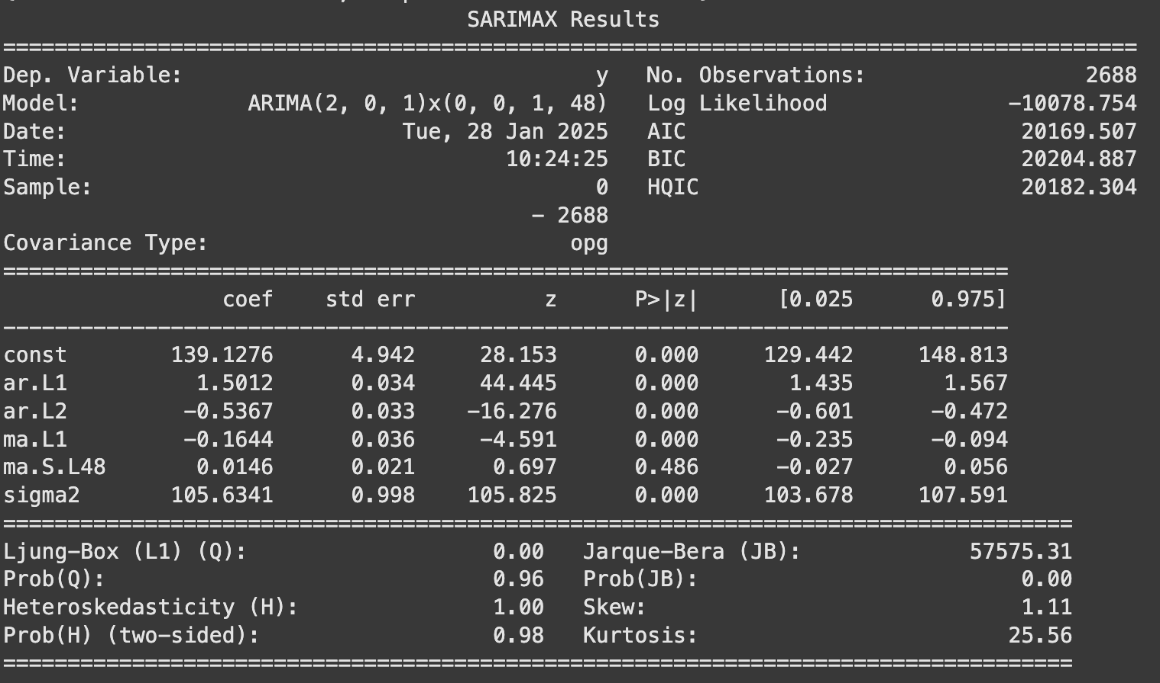
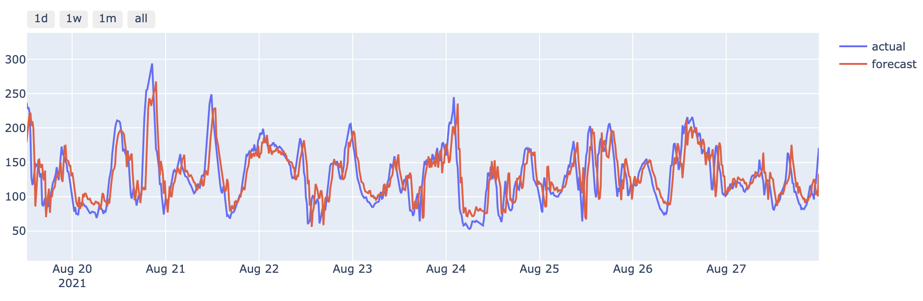
ARIMA - results
Best model:
Order: (2,0,1) x (0,0,1,12h)
Worse than naïve?!
Naive | RMSE | MAPE
Task 1* | 25.9 | 17.4%
Task 2*

Slide 20
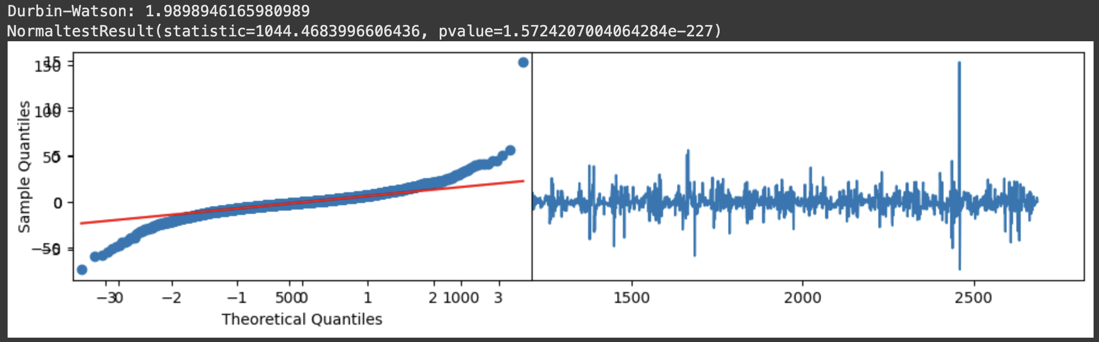
Arima - details
Not an optimal fit:
Non-normally distributed error
Seasonality not significant
Big spikes result of interpolation?
Does not include exogenous factors / covariates

Slide 21
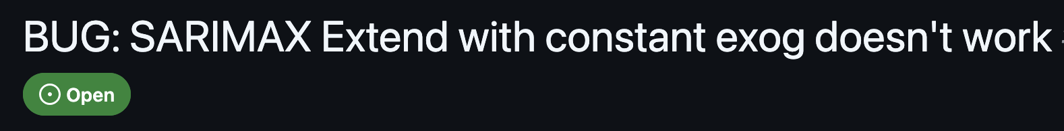
Arima-X: Using exogenous features?
Some technical problems....

Slide 22
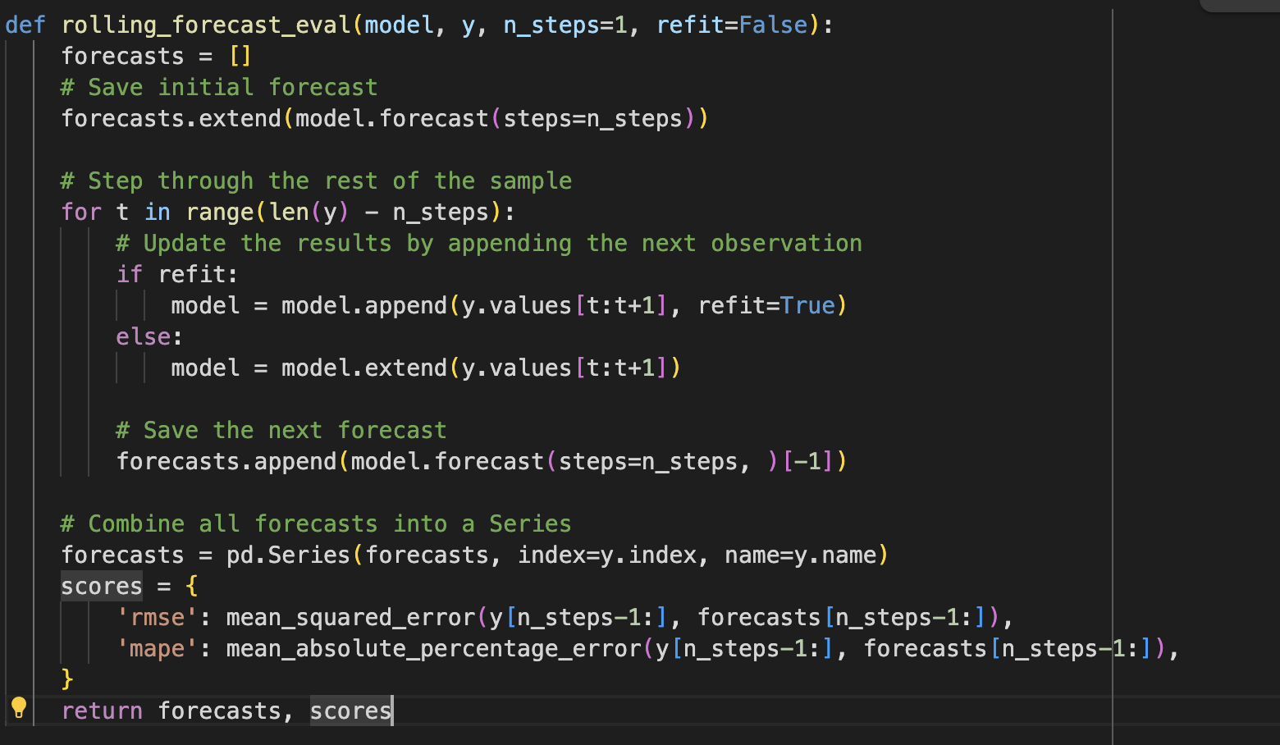
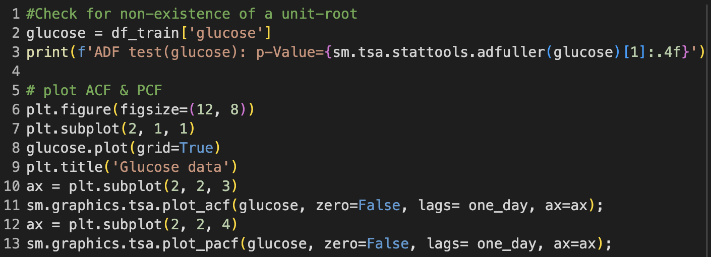
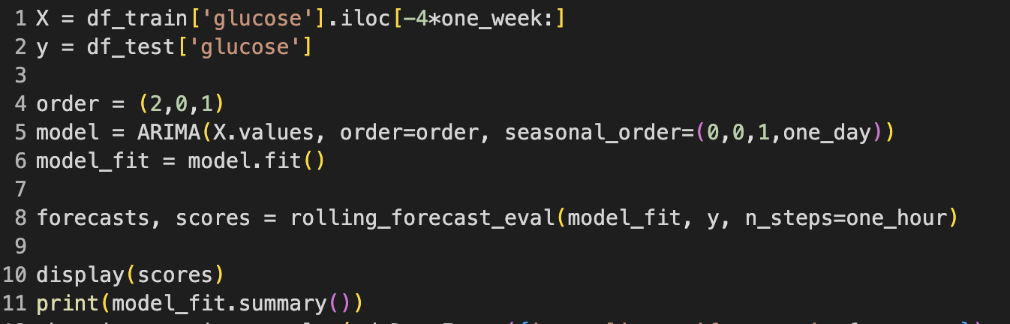
ARIMA – Code snippets
Implemented using statsmodels

Slide 23
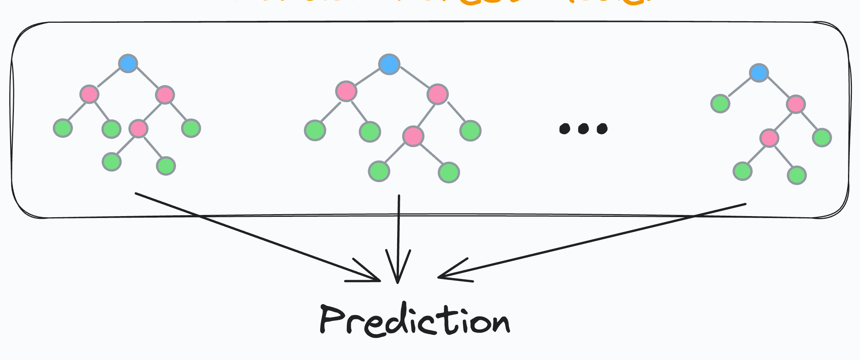
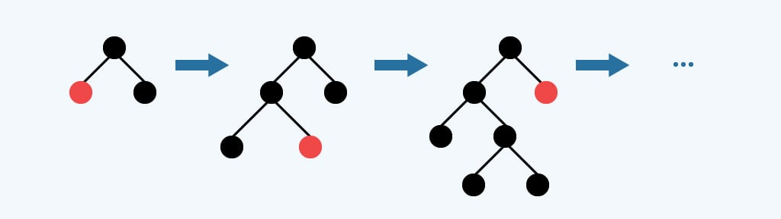
Regression Tree ensembles boosting & Baggging
Why?
Handle non-linear relationships well
Provide feature importance rankings
Less prone to overfitting due to ensemble nature
Work well with numerical time series data
Feature engineering:
Time features:
time of day (sin/cos), day of week, month
Lag features:
6h lag
Glucose level, heart rate, insulin

Slide 24
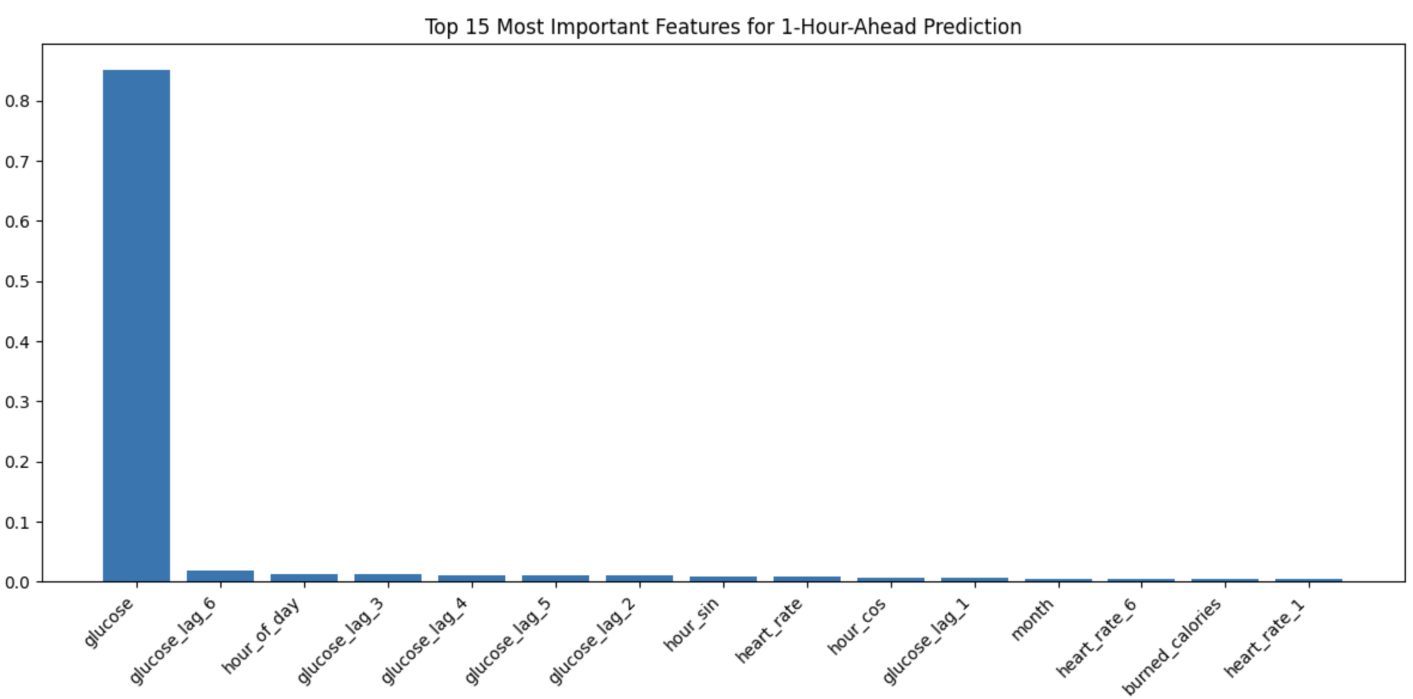
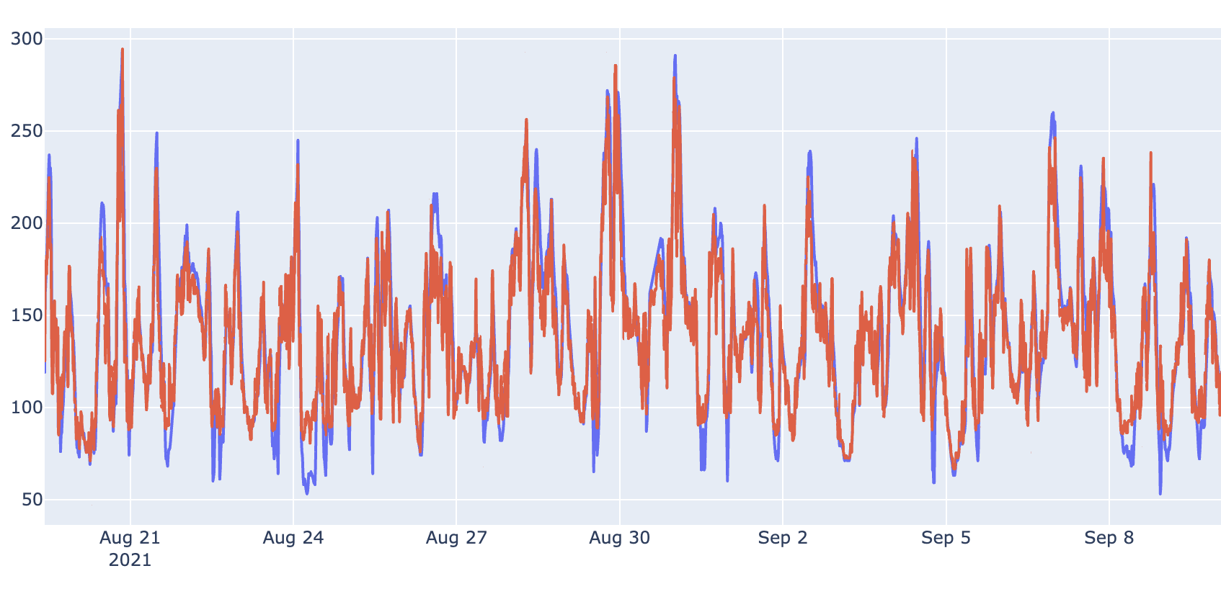
Random Forest
GridsearchCV:
param_grid = {
'n_estimators': [25, 50, 100],
'max_depth': [5, 10],
}
Best parameters:
{'max_depth': 10, 'n_estimators': 50}
RF | RMSE | MAPE
Task 1a | 16.8 | 11.2%

Slide 25
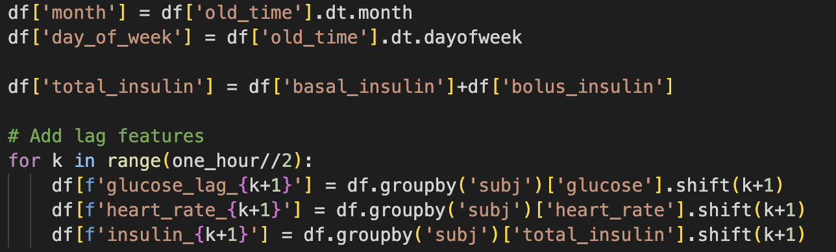
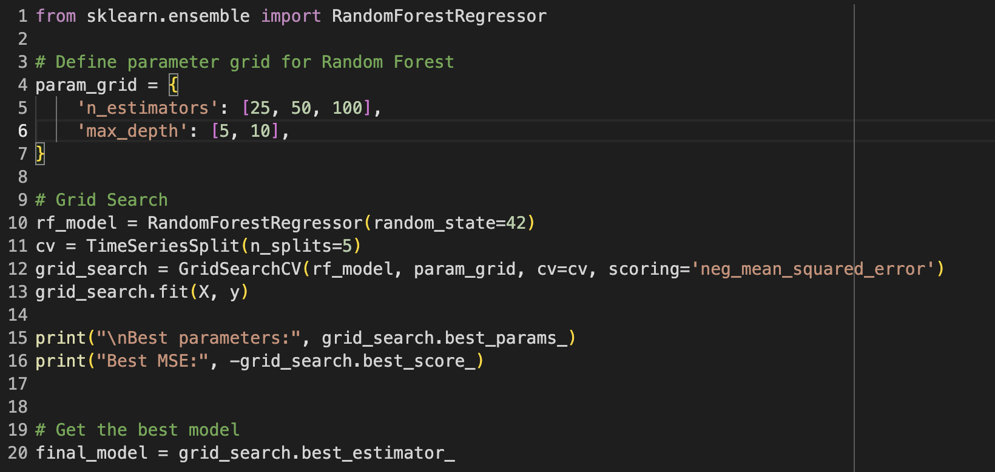
random forest -Code snippets
Feature engineering via pandas
Ordinary sklearn pipeline for training

Slide 26
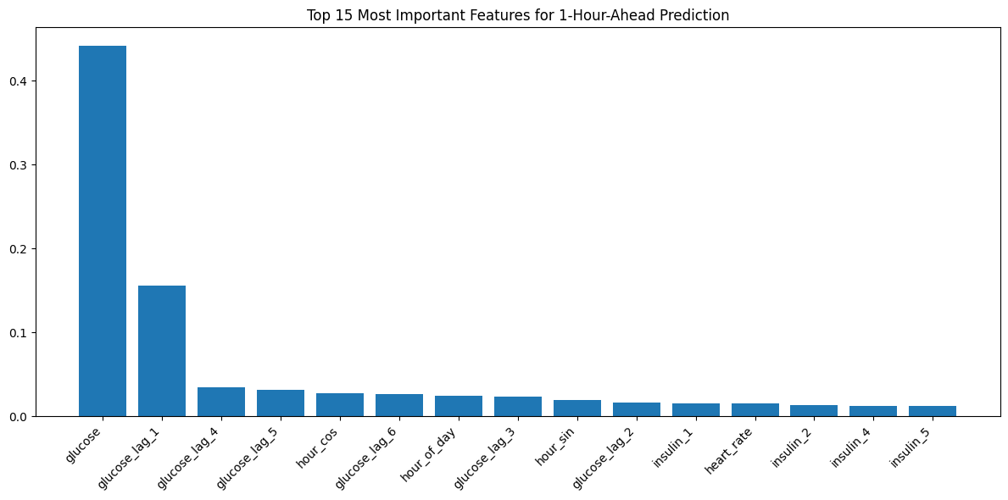
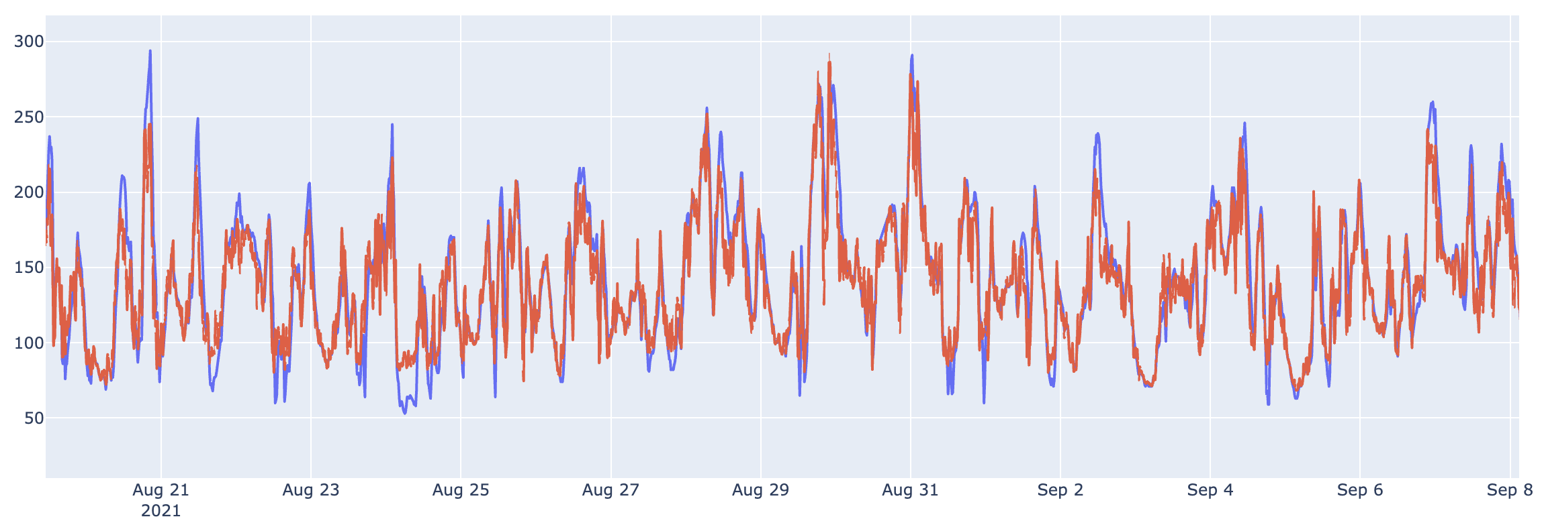
XGBoost
GridsearchCV:
param_grid = {
'n_estimators': [50, 100, 200],
'max_depth': [5, 10],
'subsample': [0.8, 1.0],
'colsample_bytree': [0.8, 1.0]
}
Best parameters: {'colsample_bytree': 0.8, 'max_depth': 5, 'n_estimators’: 200, 'subsample': 0.8}
RF | RMSE | MAPE
Task 1a | 17.6 | 11.9%

Slide 27
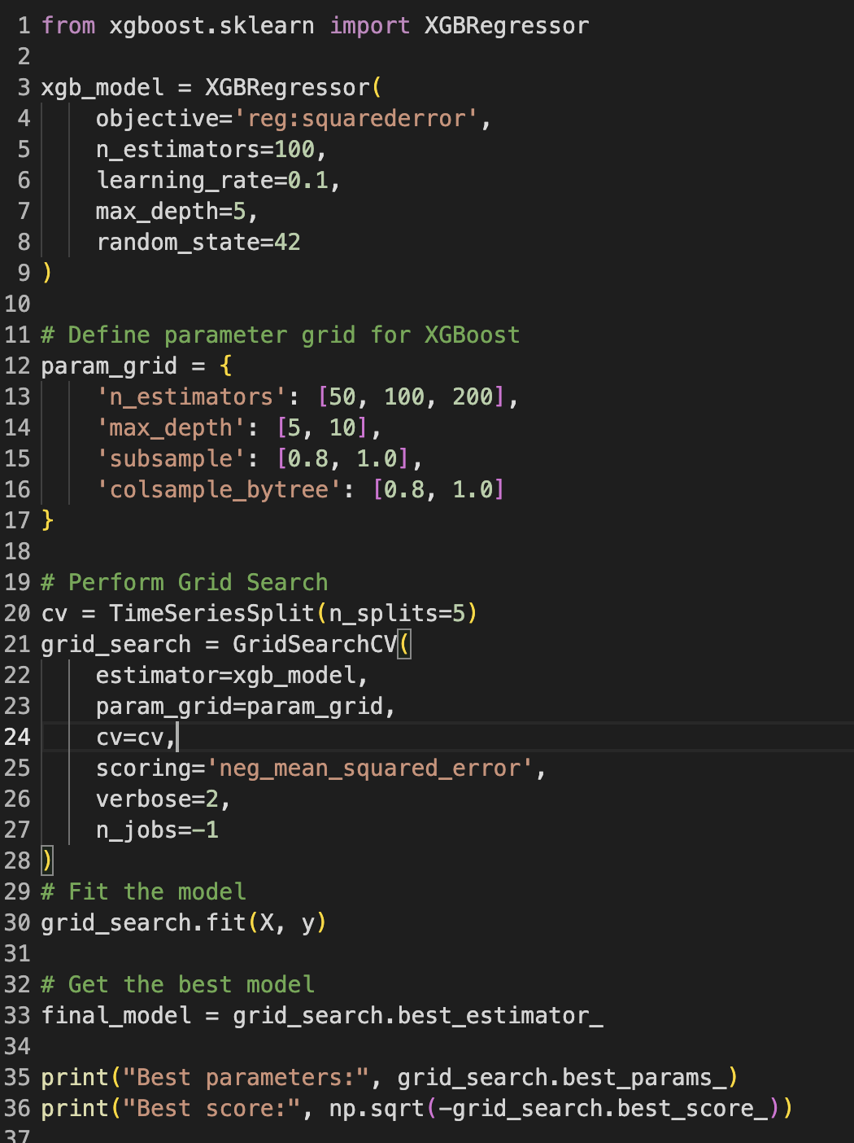
XGBOOST – CODE SNIPPETS
xgboost library → sklearn model

Slide 28
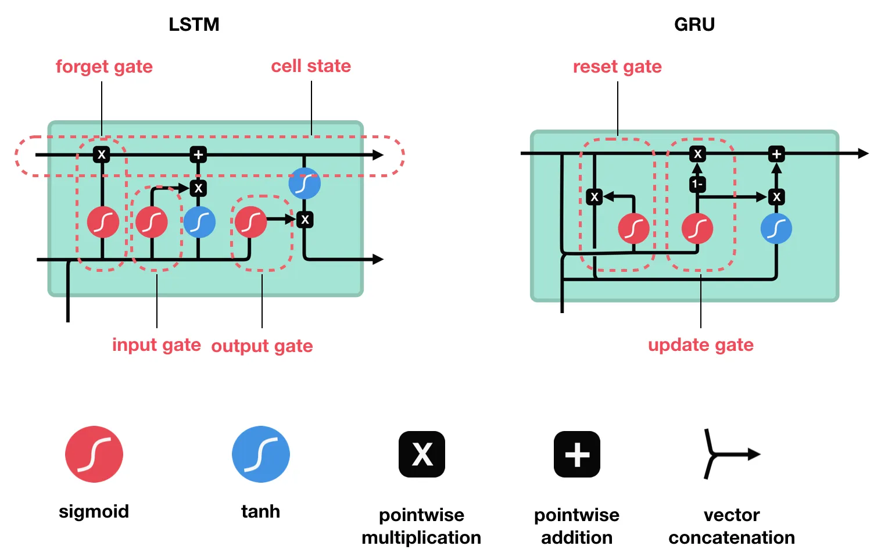
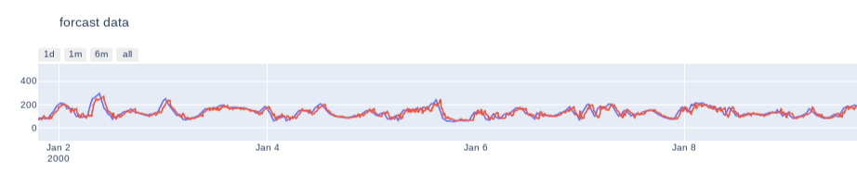
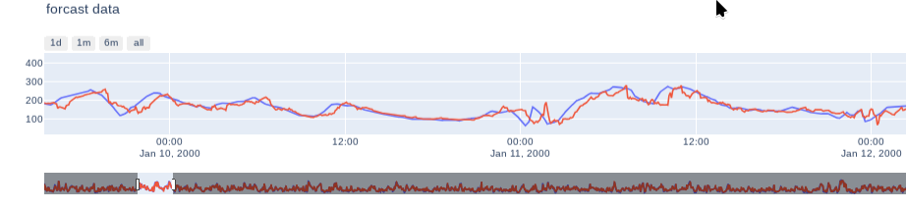
Recurrent Neural Networks
GRU
GRU | RMSE | MAPE
Task 1a | 23.8 | 14.3%
uvar GRU(64/ReLu) 60->60min
GRU | RMSE | MAPE
Task 1a | 23.0 | 14.8%
mvar GRU(64/ReLu) 120->60min

Slide 29
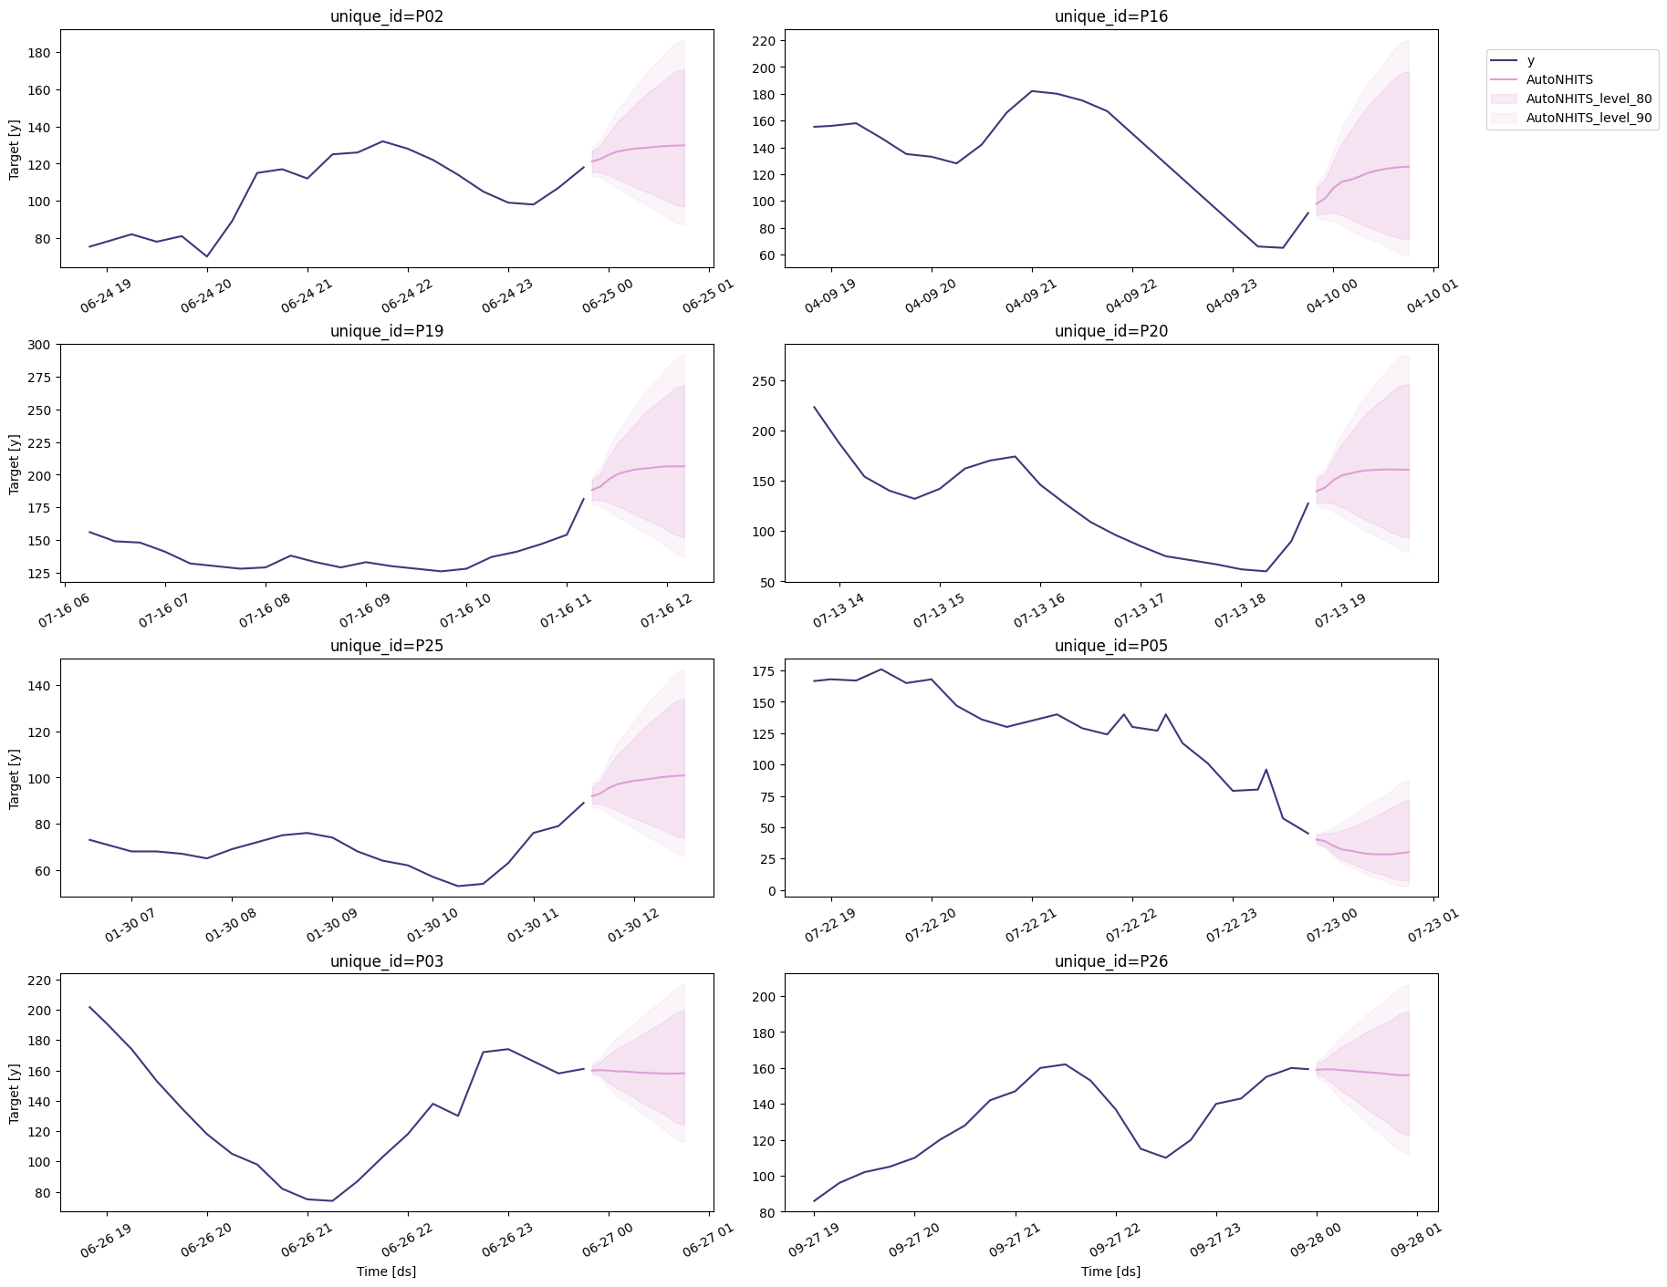


Modern Deep Learning Architectures
N-Hits
N-Hits | RMSE | MAPE
Task 1a | 23.8 | 14.9%

Slide 30
LSTM
Capturing Long-Term Trends LSTMs can model long-term dependencies in blood sugar trends by understanding the impact of past glucose levels, meals, medications, and activities. This is crucial for managing blood sugar, as patterns often depend on events hours or even days earlier.
Handling Irregular and Noisy Data Blood sugar data can be noisy (e.g., due to sensor inaccuracies) and may have gaps or irregular intervals. LSTMs can process such sequences effectively, preserving temporal relationships and learning meaningful patterns despite variability in the data.
LSTM | RMSE | MAPE
Task 1a | 18.3 | 12.7%

Slide 31

LSTM – CODE SNIPPETS
optuna → hyperparam opt.

Slide 32

LSTM

Slide 33

CHRONOS FOUNDATION MODEL
Pretrained time series forecasting models based on language model architectures
“A time series is transformed into a sequence of tokens via scaling and quantization, and a language model is trained on these tokens using the cross-entropy loss”
Zero-shot application
Fine-Tuning

Slide 34

CHRONOS - ZERO SHOT RESULTS
Zero-shot | RMSE | MAPE
Task 1a | 25.0 | 15.3%
Good performance for zero shot
Only glucose levels used no other features!
Just the ‘bolt-small’ model
→ bigger = better ?

Slide 35

CHRONOS – CODE SNIPPETS
chronos-forecasting library for zero-shot evaluation

Slide 36


CHRONOS - COVARIATES & FINE TUNING RESULTS
No full evaluation yet…
But first results: Not better than zero-shot :(
Zero-shot | RMSE | MAPE
Task 1a | 27.0 | 17.0%

Slide 37


CHRONOS – CODE SNIPPETS
AutoGluon for customization and finetuning

Slide 38
RESULT OVERVIEW
Models | RMSE | MAPE
Naive | 27.0 | 17.0%
ARIMA | 25.9 | 17.4%
RandomForest | 16.8 | 11.2%
XGBoost | 17.6 | 11.9%
LSTM | 18.3 | 12.7%
GRU | 23.8 | 14.3%
N-Hits | 23.8 | 14.9%
Chronos | 27.0 | 17.0%

Slide 39
DISCUSSION
Most models not much better than the naive baseline :/
Tree based models most successful

Slide 40
OUTLOOK
Additional feature engineering
Anthropometrics (age, gender, height, etc.)
Sleep features
Time since last meal, avg activity level, etc.

Slide 41

Q&A
It looks like you have some questions. How can I help you?
Yes
Cancel

Slide 42
LITERATURE
Hidalgo et al., Alvarado, J.,Botella, M., et al. (2024): HUPA-UCM diabetes dataset. Data in Brief, 55, 110559. https://doi.org/10.1016/j.dib.2024.110559
Azur, M. J., Stuart, E. A., Frangakis, C., & Leaf, P. J. (2011). Multiple imputation by chained equations: what is it and how does it work?. International journal of methods in psychiatric research, 20(1), 40–49. https://doi.org/10.1002/mpr.329
Ansari A. F., Stella L., Turkmen, C, et al.. (2024). Chronos: Learning the Language of Time Series. Transactions on Machine Learning Research. https://doi.org/10.48550/arXiv.2403.07815

